Slide 1
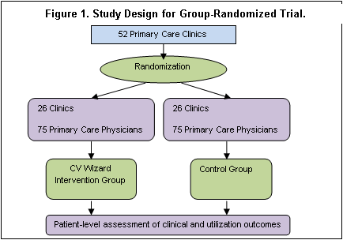
SMI Wizard : RCT to Reduce CV Risk
Cluster-randomized clinical trial that includes 50+ primary care clinics (150 PCPs, 2250 adults with SMI) at HP, Essentia & PN blocked within organization and randomly assigned 1:1 to SMI Wizard or control arms

Slide 2
SMI Wizard : Partner Sites
HealthPartners
Rebecca Rossom, PI
JoAnn Sperl-Hillen, Co-I
Patrick O’Connor, Co-I
Kris Ohnsorg, PM
Amy Boelter, RA
Lauren Crain, Stats Co-I
Jerry Amundson, Epic Programmer
Deepa Appana, Web Programmer
Essentia
Steve Waring, Site PI
Joseph Bianco, Co-I
Allise Taran, Site PM
Paul Hitz, Programmer
Lisa Wilkinson, Epic Programmer
Park Nicollet
Kris Kopski, MD, PhD, Co-I
Jeanine Rosner, MPH Co-I
Rashmi Sharma, Web Programmer
Olga Godlevsky, Programmer
Vij Thirumalai, Programmer
Prasad Pasumarthi, Programmer
Consultants:
Russell Luepker, Ben Druss

Slide 3
SMI Wizard : Aims
Primary Aim: Determine whether adults with SMI receiving care in intervention clinics will have, compared to those receiving care in control clinics:
Hypothesis 1: Lower total modifiable CV risk
Hypothesis 2: Better control of specific modifiable risk factors:
BP, Lipids, Obesity, A1c, Smoking, Aspirin Use
Hypothesis 3: Lower rates of prescriptions for obesogenic SMI
medications at 12 months post-index
Secondary Aim: Explore impact on CV risk factor identification, treatment initiation/intensification, adherence, outpatient/inpatient utilization, risky prescribing events, CV events

Slide 4
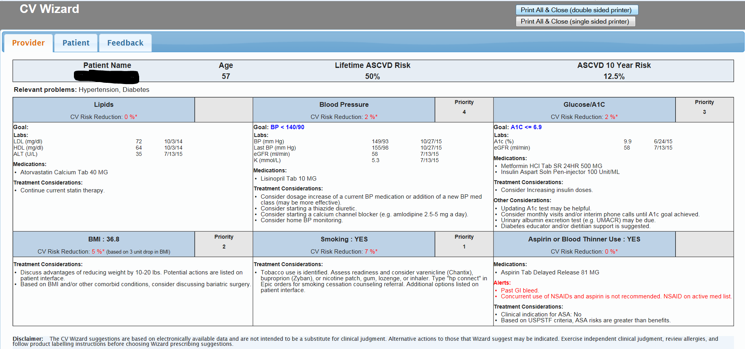
RCT to Reduce CV Risk in Adults with SMI: Provider Sheet

Slide 5
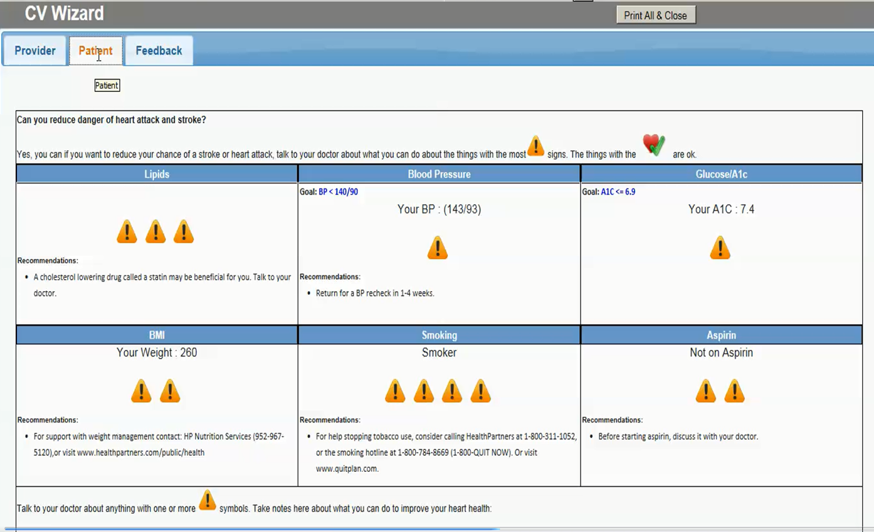
RCT to Reduce CV Risk in Adults with SMI: Patient Sheet

Slide 7
SMI Wizard : Key Timeline Dates
Sept 2015: Testing at HPMG
Oct 2015: Pilot at HPMG
Jan 2016: Implement at HPMG
April 2016: Pilot at Essentia
July 2016: Implement at Essentia (randomized clinics 2:1 intervention: control; 34 clinics randomized instead of 24)
Jan 2017: Pilot at Park Nicollet
March 15th 2017: Implement at Park Nicollet

Slide 8
DMSB Meetings
Members
  Jin Hui Joo, Johns Hopkins (chair)
  Joe Koopmeiners, Univ of MN
  Marsha Wittink, Univ of Rochester
Most recent meeting: Nov 2016
  No concerns about recruitment, fidelity, safety
Upcoming meeting: May 2017

Slide 9
Recruitment & Fidelity
As of Nov 2016, 2987 patients enrolled
Print rates as of Feb 2017
  Essentia:73%
  HPMG: 72%
  Print rate reports provided at clinic and provider levels
  Incentives for continued high use

Slide 10
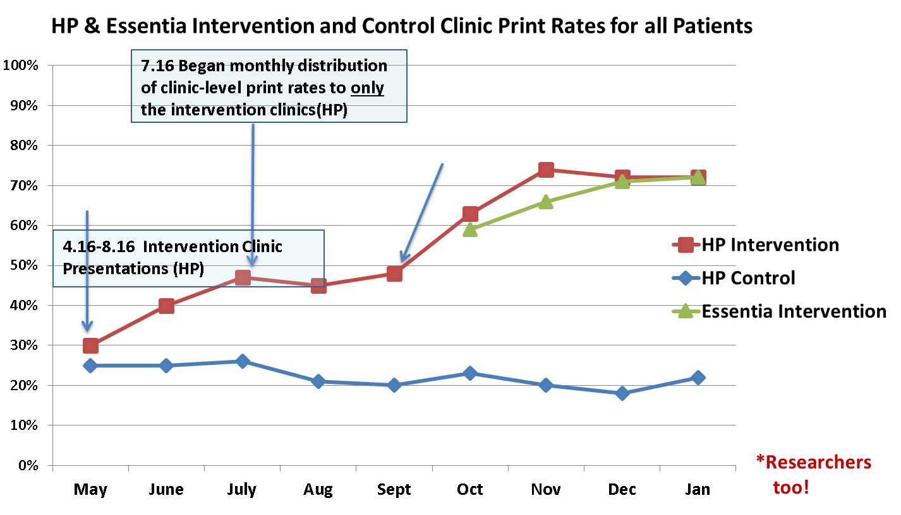
Nurses and Docs are Competitive*
9.16 Began monthly distribution of provider-specific print rate reports, incentive plan announced, rooming staff flyer distributed (HP)
5.16 Began monthly distribution of clinic-level print rate reports to both intervention and control clinics (HP)

Slide 11
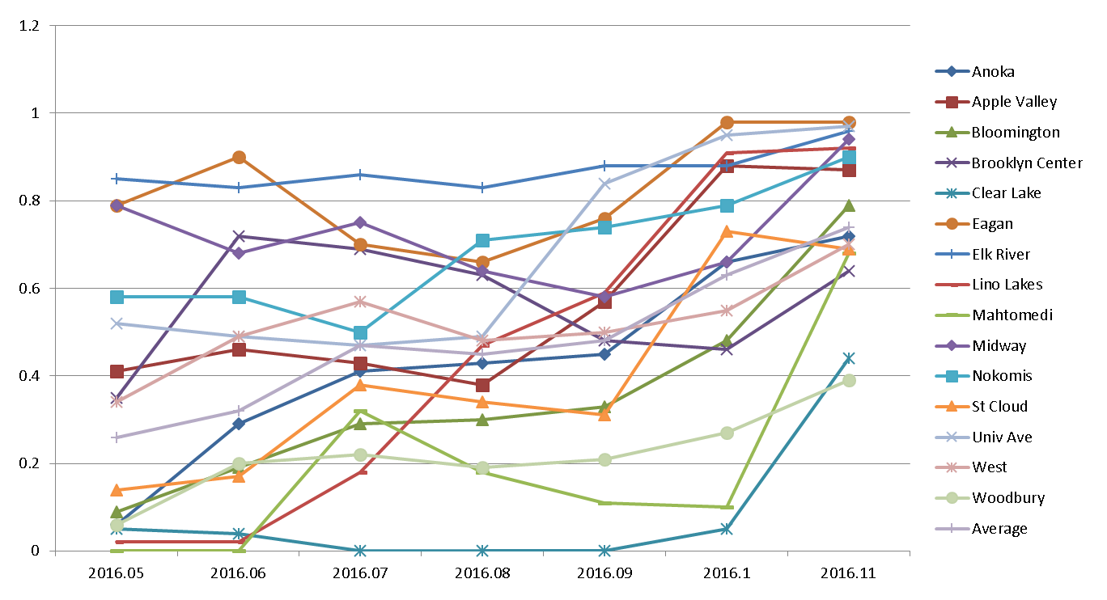
Print Rates at HPMG Intervention Clinics

Slide 12
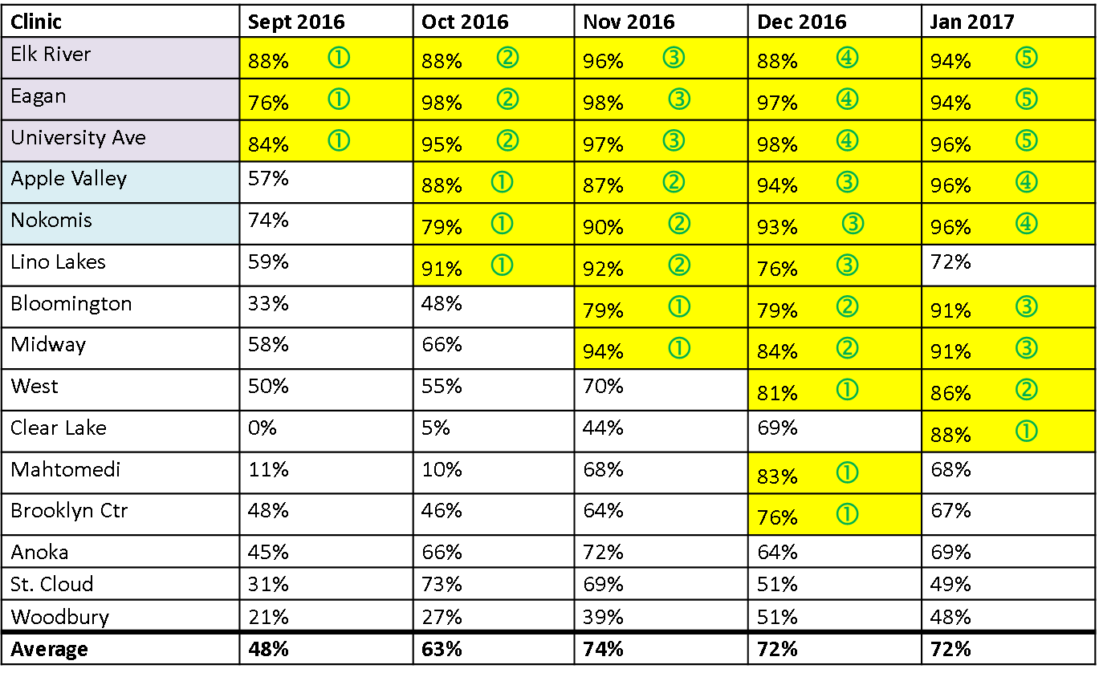
More Fostering of that Competitive Spirit
& unabashed bribery…

